Slide 1
Key words
Electric Potential
Electric potential energy
Equipotential surface
Electron-volts
Isolated conductor
Insulator

Slide 2
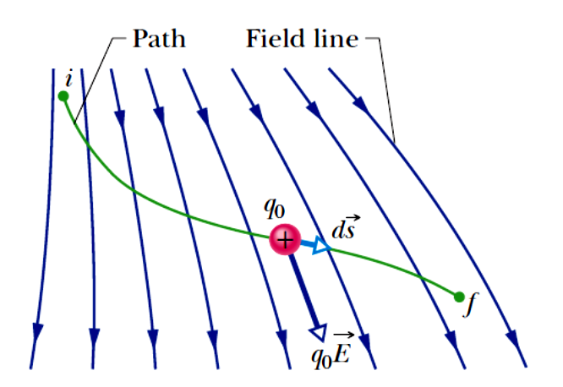
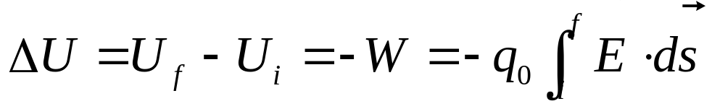
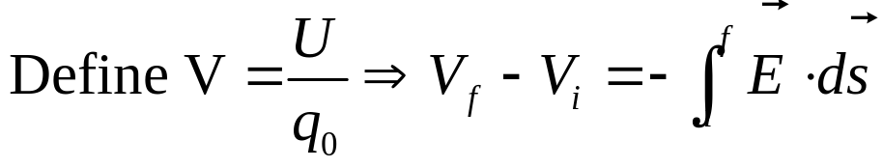
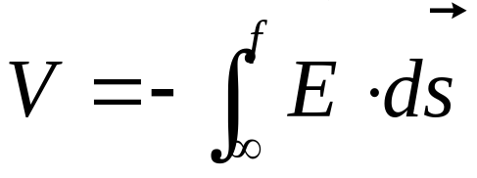
Electric Potential
If i is chosen as reference point where U is 0, V_{i} is 0 , then we have:
（infinity ∞ is a reasonable choice for most situation ）

Slide 3
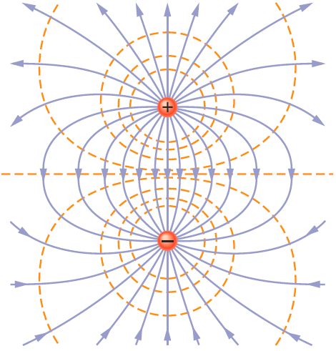
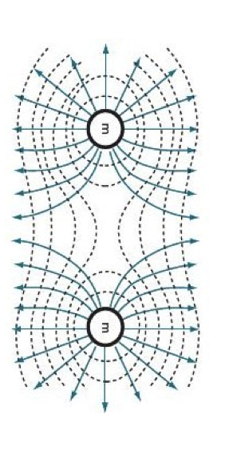
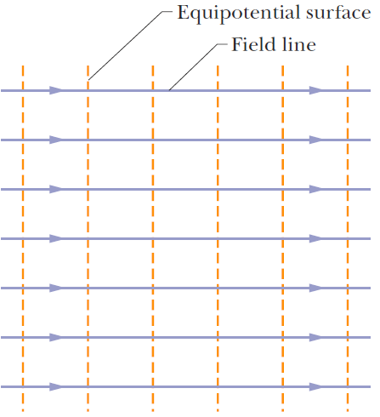
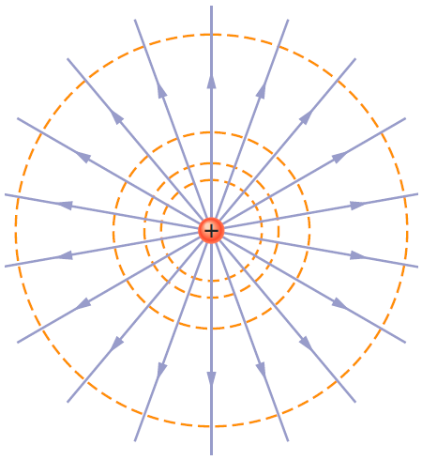
Equipotential Surfaces and the Electron Field
+
+
E field lines must be always along the normal direction of the Equipotential surfaces

Slide 4


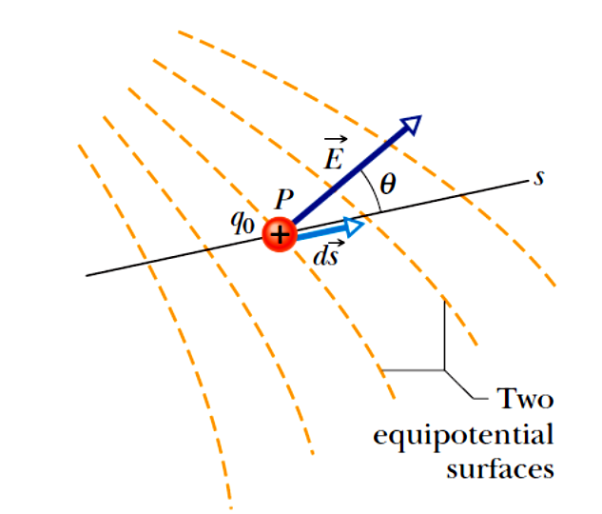


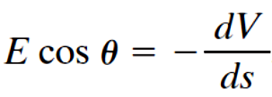
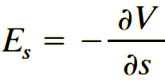
Calculating E from V
The s component of E vector
E_{s} is the negative rate of potential along s direction

Slide 5
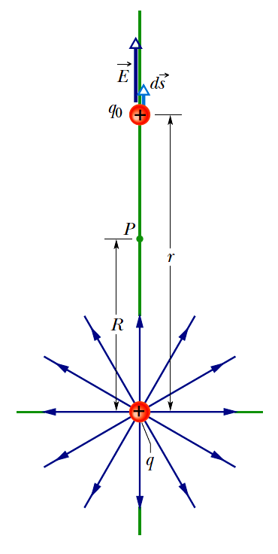

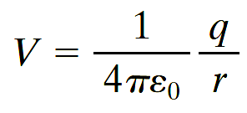
Electric potential due to a charged particle

Slide 6
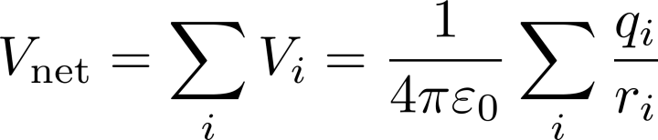
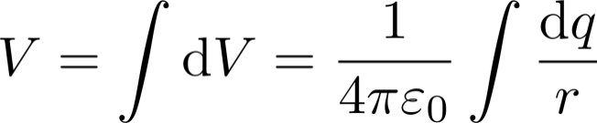
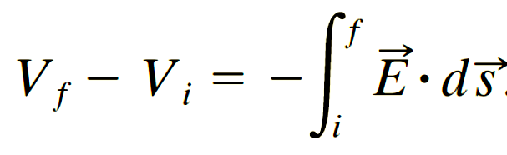
Methods to calculate V due to given charge distribution
Method 1: Using the principle of superposition:
Net potential for discrete charged particles is the scalar sum of individual potential
When charges are distributed continuously, the sum is replaced by an integral.
Usually, for charge with regular shape:
Method 2: Calculate V from E field:
Usually for the charge with special symmetry such that it’s easy to use gauss’s law to calculate the E field

Slide 7
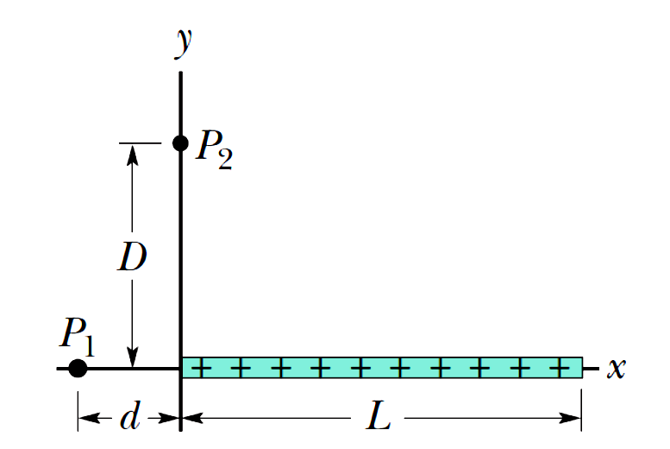
Problem 1
The thin plastic rod of length L = 12.0 cm has a nonuniform linear charge density λ= cx, where c = 49.9 pC/m².
(a) With V = 0 at infinity, find the electric potential at point P₂ on the y axis at y = D = 3.56 cm.
(b) Find the electric field component E_{y} at P₂.

Slide 8
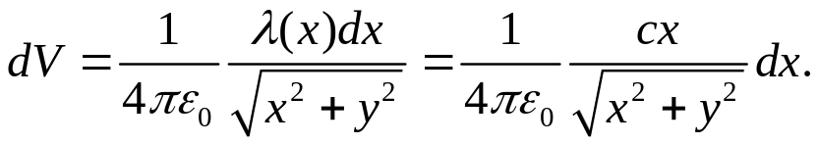
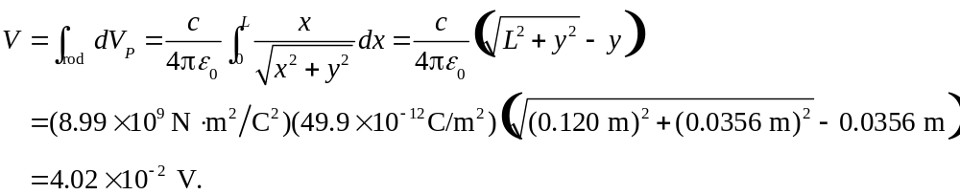
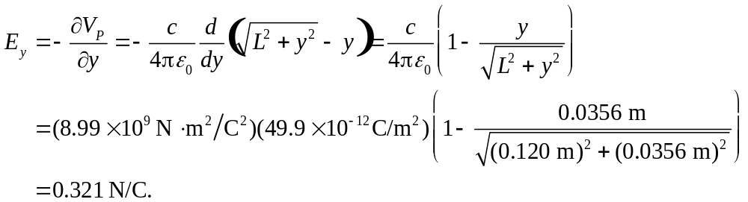
Problem 1
(a) Consider an charge element of the rod from x to x + dx. Its contribution to the potential at point P₂ is
(b) The y component of the field is

Slide 9
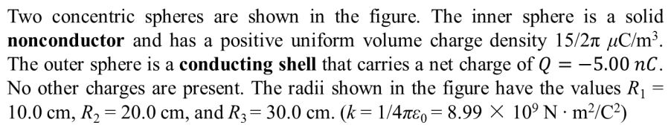
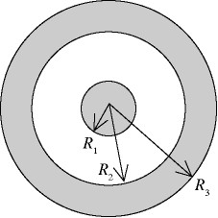
Problem 2
Find the total excess charge on the inner nonconductor, inner and outer surfaces of the conducting sphere.
(b) Find electric field magnitude and direction
(pointing outward or inward) of the electric
field E and the potential V (With V = 0 at
infinity) at the following distances r from the
center of the inner sphere: (i) r = 60cm, (ii)
r=15cm, (iii) r=5cm .
(c) Sketch E(r) and V(r).

Slide 10
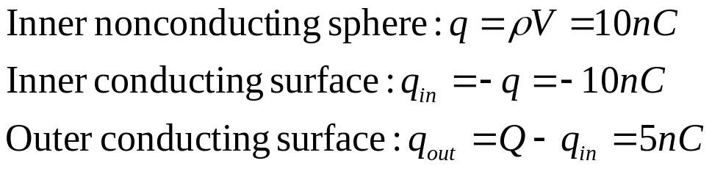

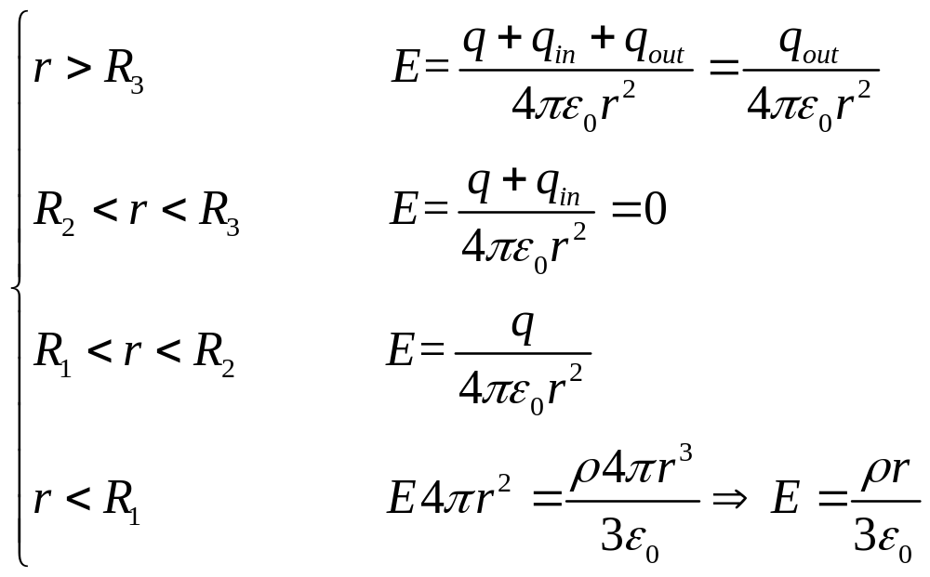
Problem 2
Solution: a)
b)
According to Gauss’ law:

Slide 11
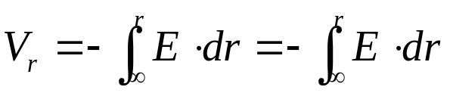
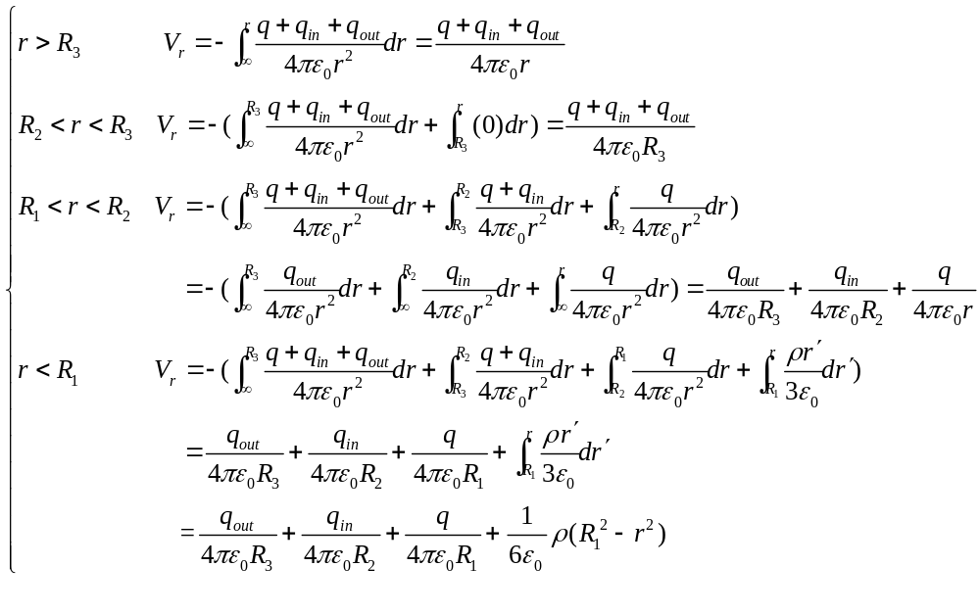
Problem 2

Slide 12
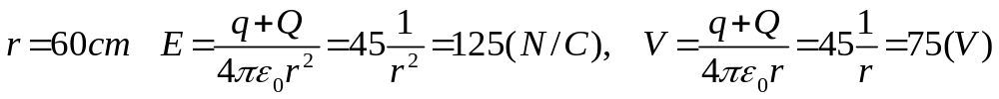
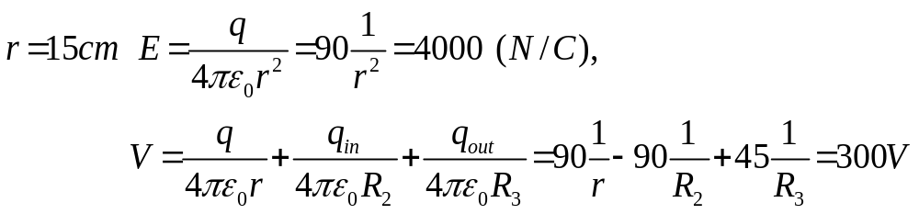
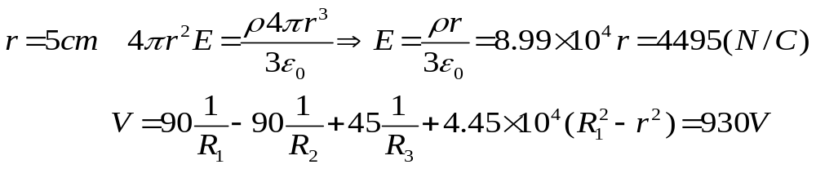
Problem 2

Slide 13
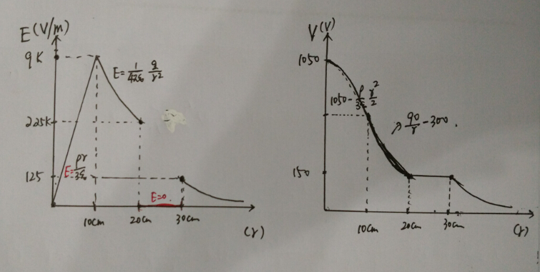
Problem 2
c)

Slide 14
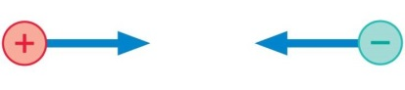
Problem 3
A positive and a negative charge are released from rest in vacuum. They move toward each other. As they do:
A)A positive potential energy becomes more positive.
B)A positive potential energy becomes less positive.
A negative potential energy become more negative.
A negative potential energy becomes less negative.
A positive potential energy becomes a negative potential energy.

Slide 15
Problem 3
A positive and a negative charge are released from rest in vacuum. They move toward each other. As they do:
A)A positive potential energy becomes more positive.
B)A positive potential energy becomes less positive.
A negative potential energy become more negative.
A negative potential energy becomes less negative.
A positive potential energy becomes a negative potential energy.

